Slide 1
.Net Framework

Slide 2

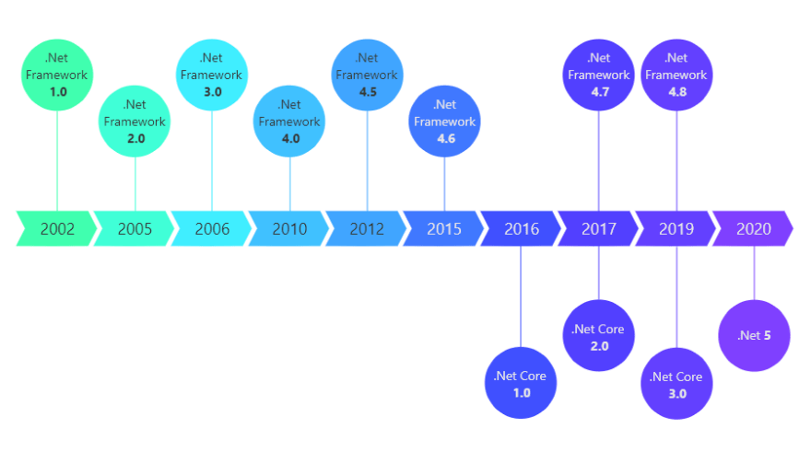

Slide 3
.Net Frameworks:
Net framework has come a long way since then, and the current version is 5.0
.Net is a framework to develop software Applications
It is designed and developed by Microsoft and the first beta version released in 2000.
It is used to develop applications for web, Windows,…
It provides a broad range of functionalities and support.

Slide 4
The .NET Framework supports more than 60 Programming languages such as C#,F#, VB.NET, J#,VC++,Jscript.NET,COBOL,Perl,ML,Pascal.
The .Net Framework is composed of four main components:
Common Language Runtime.
Framework Class Library.
Core Languages(WinForms, ASP.NET and ADO.NET)
Other Modules(WCF, WPF, WF, Card Space, LINQ, Entity Framework, Parallel LINQ, Task Parallel Library etc.

Slide 5
C#

Slide 6
C# (C-Sharp) is a programming language developed by Microsoft that runs on the .NET Framework.
C# is used to develop web apps, desktop apps, mobile apps, games and much more
Now C# is on version 8.0
It is simple Interoperability,scalable,structured programming language.
Has rich Library.

Slide 7


